Slide 1
Friendswood Drainage Sub-Committee
Observations, Conclusions, and Recommendations to Friendswood City Council April 1, 2019

Slide 2

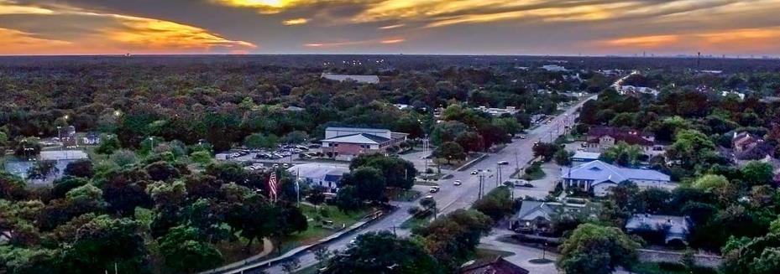
One Recommendation to Solve Flooding in Friendswood
And…..we are done! April Fools!

Slide 3
Drainage Sub-Committee
Chartered by Friendswood City Council June, 2018 - ad hoc team | Formed and started meeting June 28, 2018
Has met 35 times since then…over 500 of hours of work | Team Members….
Person | Role |  | Person | Role
Assigned Members
James Stahl | Community Representative |  | Lee Coggins | Community Representative
Ron Lovely | Community Representative |  | Kenny Koncaba | Community Representative
Gary Harris | Gal. County Cons. Drainage District |  | Marcus Rives | Gal. Co. Cons. Drainage District
Ken Clark | Galveston County Commissioner |  | Carl Gustafson | Friendswood City Council
Morad Kabiri | Friendswood City Manager |  | Steve Rockey | Friendswood City Council – Chair
Myron Jones | Harris County Flood Control District |  | Lance Gillian | Harris County – Rodney Ellis Office
Ad Hoc Members
Dawn McDonald | State Rep. Dennis Paul’s Office |  | Jed Webb | US Congressman Randy Weber’s Office
Jackie King | State Senator Larry Taylor’s Office |  | Fay Picard | State Rep Dr. Greg Bonnen’s Office
Melissa Washington | Texas General Land Office |  | Shakhar Misir | US Army Corps of Engineers

Slide 4
Presenting Tonight
Team members James Stahl and Lee Coggins……however the presentation was developed by the whole team.
We have been following a process and have already presented our problem statement, a significant portion of the data, and analysis.
Tonight we have some analysis to present. We will also be presenting our Observations/Conclusions and we will present recommendations.
AND….there are no formulas to learn tonight!!

Slide 5
Harvey Damage Data
After Harvey, City Public Works staff visited all damaged buildings and homes and from the outside estimated the level of flooding.
Did not enter houses, they just measured from the water marks on the outside of the house above the slab level.
We believe this data to be accurate within a few inches in either direction.

Slide 6
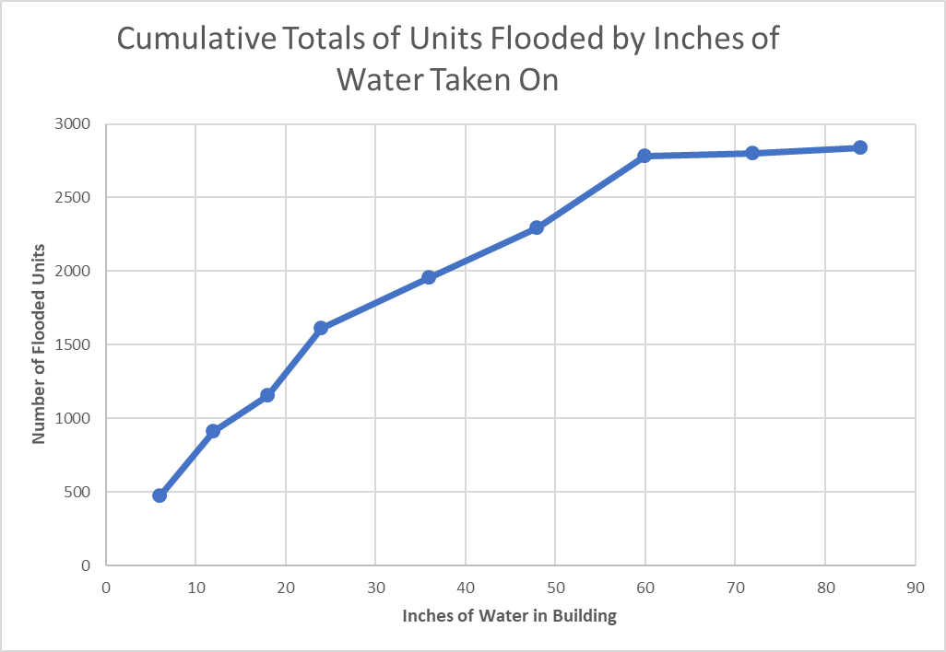
Elevation of Flooding in Housing For Harvey

Slide 7
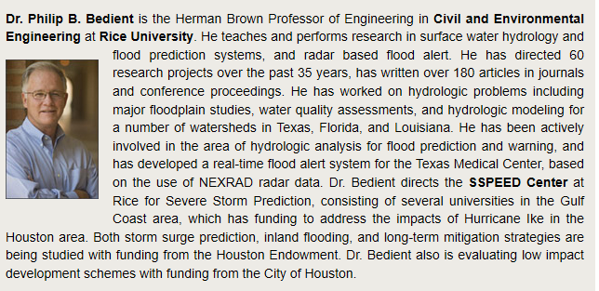
Modeling the Creek by Rice University
Recall that we hired Dr. Bedient and his team from Rice University to model Clear Creek in Friendswood.
His team has reported back with their model and they measured the effects of various proposed projects.
We intend to keep the relationship with Dr. Bedient’s work and have future items modeled.

Slide 8
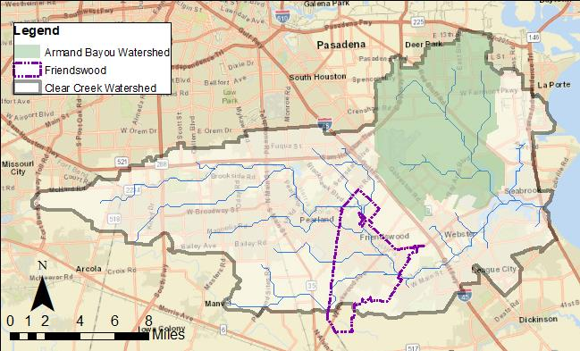
Dr. Bedient’s Work - Background of Study Area
Overall Study Area & Modeling Domain
Clear Creek Watershed
Armand Bayou Watershed
Study Focus: City of Friendswood
Primarily residential and commercial development
Flood drivers:
Low slopes
High imperviousness
Proximity to coast
Turkey Creek
Mary’s Creek
Coward’s Creek
Chigger Creek

Slide 9
What Was Evaluated
Assess existing flood vulnerability with mathematical modeling.
Validate the model against the observed flooding seen in Harvey.
Explore a variety of mitigation scenarios:
Bridge Raising
De-snagging
Channelization and Terracing
Diversion at Outlet
Proposed Detention Ponds
Model multiple scenarios to determine best group

Slide 10
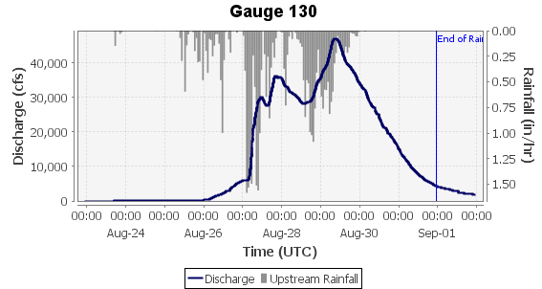
Modeling Framework
Rainfall
Water Surface Elevations
Vflo®
HYDROLOGIC MODEL
HEC-RAS
1-D HYDRAULIC MODEL
Soils
Peak Flows
Land Use
Floodplain Maps
We do not intend to show all Dr. Bedient’s data tonight however there is a 60 pages slide presentation that will be made public of his team’s work and there will be a final report.
Notes:
Tasks were completed with:
VFlo and HEC-RAS 1-D models
100 yr. rainfall data (HCFCD)
Atlas 14 100 yr. rainfall data (NOAA, 2018)
Harvey gage-corrected radar rainfall data
2018 Lidar

Slide 11
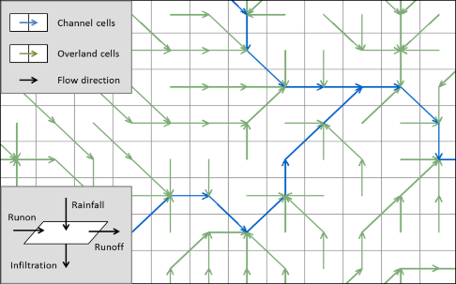
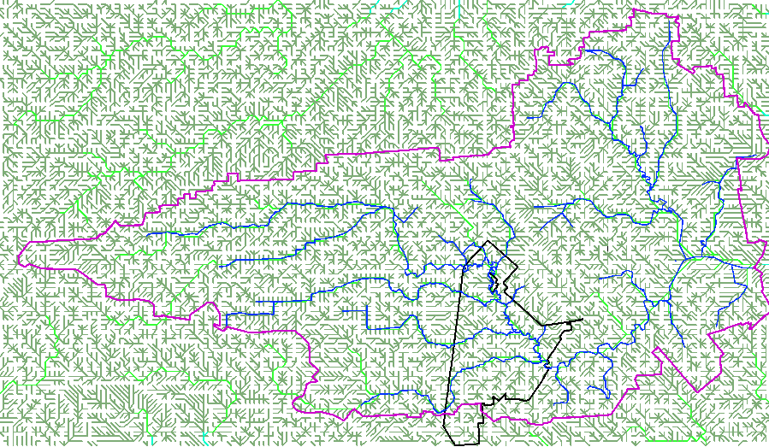
Distributed Hydrologic Model - Vflo®
Fully distributed physics-based hydrologic model developed by Vieux and Associates, Inc.
Infiltration calculated by Green and Ampt Equation
Uses Kinematic Wave to route runoff between overland grid cells and Modified Puls for channel cells
Rainfall input can be rain gauge data or radar rainfall

Slide 12
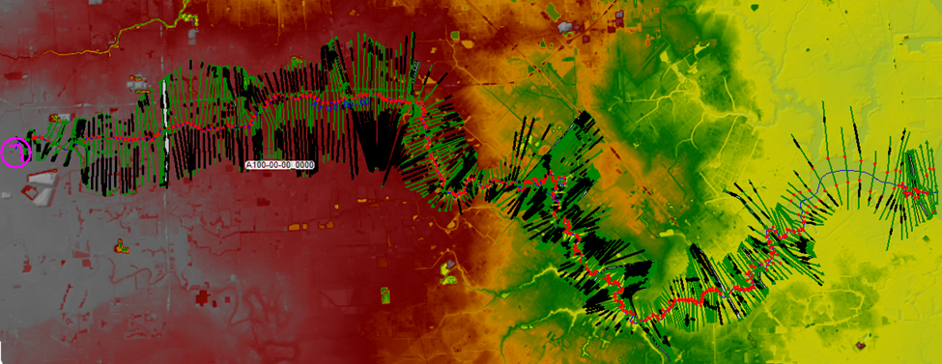
Hydraulic Model – HEC-RAS
Developed by the Hydrologic Engineering Center (HEC) of the US Army Corps of Engineers
Used in various floodplain studies and dam breach analyses
1D steady-state is used as the basis for FEMA floodplains
Existing model was obtained from HCFCD M3 system

Slide 13
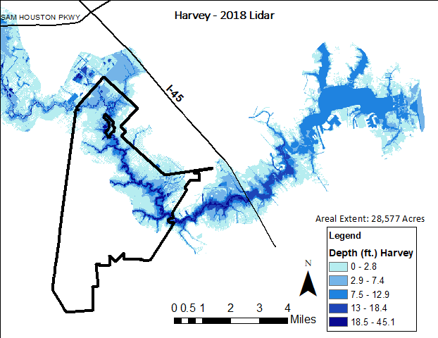
Additionally for Each Test Scenario Flood Plain Maps Can Be Predicted

Slide 14
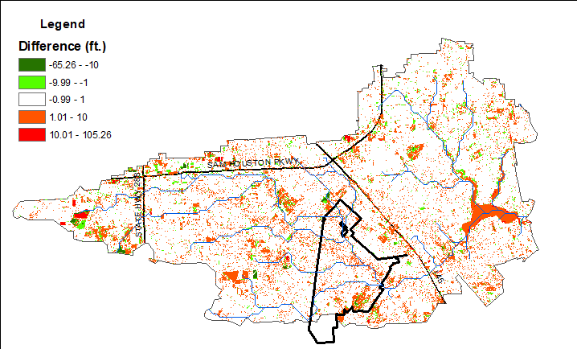
Changes in Land Use in Clear Creek Watershed Last Decade
This supports Team Observations and Recommendations Regarding Land Use, Permitting, and Watershed Changes
Changes in land use from 2008 to 2018 using LIDAR (Light Detection and Ranging).
Green shows decreases in surface elevation mostly from addition of detention ponds.
Orange and Red shows increases in land elevations due to land development.
White areas remain unchanged although some likely were changed earlier that 2008,

Slide 15
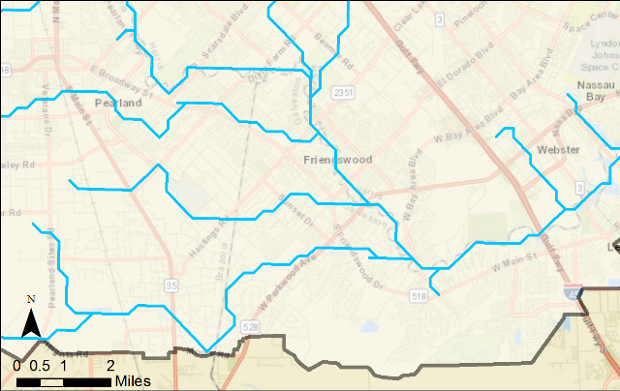
Model Validation – Peak Water Surface Elevation (WSEL) for Harvey
Measurement Location | Observed (HCFCD) WSEL | USGS High Water Mark | Modeled Peak WSEL | Difference
Gage 135 | 27.7 | 29.43 | 28.94 | -0.46
Gage 120 | 24.2 | - | 24.50 | 0.30
Gage 130 | 21.1 | - | 21.35 | 0.69
Gage 110 | 16.6 | - | 16.48 | 0.04
Gage 135
FM2351
Gage 120
FM528
Gage 110
Gulf Fwy
Gage 130
Bay Area Blvd
*All listed values are in feet
Differences this close are considered outstanding in the field of flood modeling

Slide 16
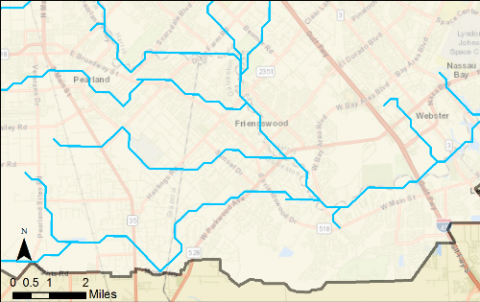
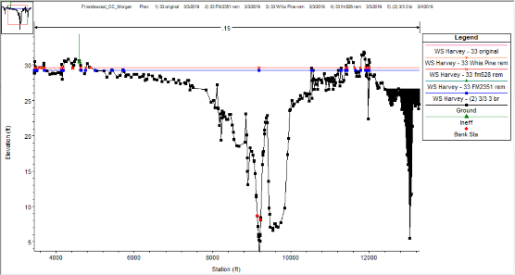
An Example of the Output for Just One (Raising the FM 2351 Bridge)
①
*Plot depicts upstream bridge raising scenario
In All Cases data was shown for the effect of the project for the historical 100 yr. storm, the new 100 year storm, and Harvey. Negative numbers indicate how much lower flooding would have been had the project been in place
Storm | Changes in Peak WSEL (ft)
 | FM 2351 | Whispering Pines | FM 528 | All 3 bridges
100 yr. | -1.69 | -0.02 | -0.04 | -1.86
100 yr. (ATLAS 14) | -0.57 | 0 | -0.01 | -0.59
Harvey | -0.38 | -0.01 | -0.01 | -0.38
Notes:
116205.8
101082.9
64820.26

Slide 17
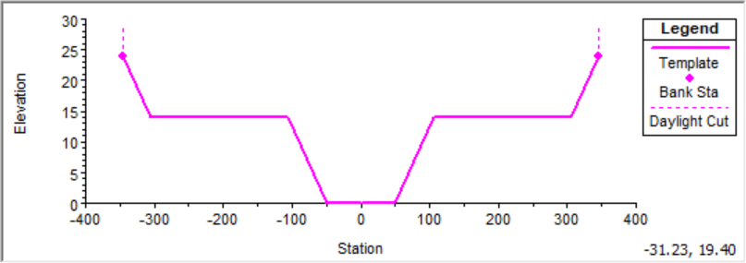
Terracing - Method
Based on the terracing design, extend a 200 ft terrace to both sides
Channel meanders remain intact (i.e., no channel straightening)
Grass terracing has a roughness coefficient of 0.04 on its terraces.
Bottom Width | Channel Depth | Side Slope (H:V) | Terracing Distance (each side) | Terracing Depth | Manning’s n (channel) | Manning’s n (grass terracing)
60 ft | 14 ft | 4 | 200 ft | 10 ft | 0.015 | 0.04

Slide 18
Summary of Scenario Individual Testing – Harvey
# | Watchpoint Location | Change in Peak WSEL (ft)
 |  | Three-Bridge Raising | Terracing | Bridge Rm + Terracing | De-Snag | 50% Diversion | Detention
1 | Upstream FM 2351 Bridge | -0.79 | -3.78 | -4.11 | -0.86 | -0.11 | -0.03
2 | Downstream FM 2351Bridge | -0.09 | -3.38 | -3.37 | -1.47 | -0.15 | -0.04
3 | Upstream Whispering Pines Bridge | -0.20 | -1.83 | -1.83 | -0.87 | -0.38 | -0.04
4 | Downstream Whispering Pines Bridge | -0.19 | -1.56 | -1.56 | -0.75 | -0.47 | -0.04
5 | Upstream FM 528 Bridge | -0.19 | -1.10 | -1.10 | -0.44 | -0.74 | -0.05
6 | Downstream FM 528 Bridge | 0.00 | -0.90 | -0.90 | -0.37 | -1.03 | -0.06
7 | Downstream Bay Area Blvd Bridge | 0.00 | -0.09 | -0.09 | 0.00 | -2.9 | -0.09
8 | Downstream I-45 Bridge | 0.00 | 0.00 | 0.00 | 0.00 | -3.62 | -0.06
9 | Clear Lake | 0.00 | 0.00 | 0.00 | 0.00 | -1.52 | -0.04

Slide 19
Dr. Bedient’s Team Calculated the Group of Projects That Would Have the Biggest Effect.
You can’t just add the numbers on the previous page because different projects interact with each other in both positive and negative ways
It turns out that raising the FM 2351, de-snagging and terracing together have the greatest positive impact.
Importantly those same projects don’t negatively effect League City.
Combination scenario decreases up to ~3.5 ft of water at Friendswood during Harvey.
The effect is more pronounced upstream of Whispering Pines and begins to diminish as you move down stream.
Land availability downstream of FM 528 is greater so increasing the terracing width there would likely increase the effect between FM 528 and Bay Area Blvd
Bedient’s will model this in the future

Slide 20
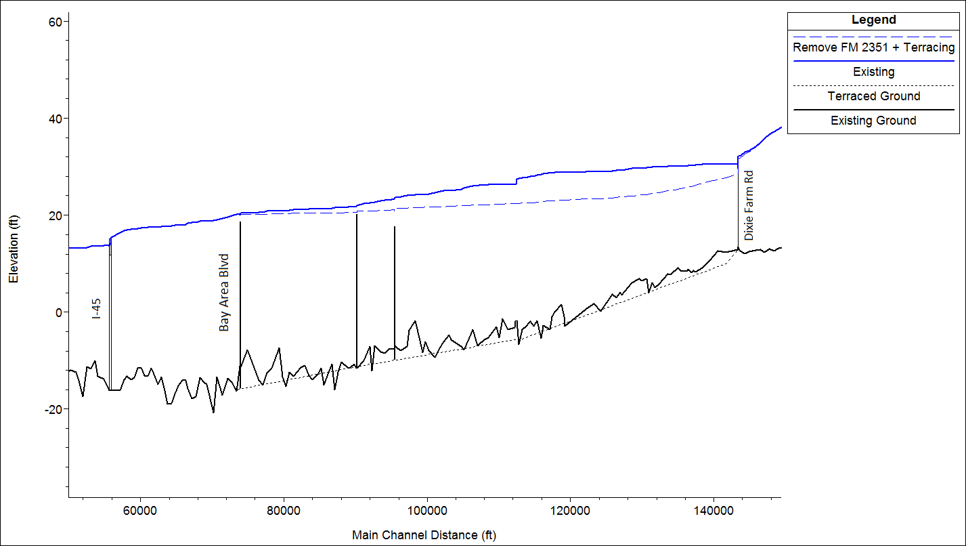
Effect of Raising FM 2351 Bridge and Terracing on Harvey Flood Levels
Raise FM 2351 + Terracing
As Noted increasing terracing width downstream of FM 528 will increase positive effect
Current I45 Bridge was an issue in Harvey. The current work raises the Bridge and Feeder Bridges and should help water move out better

Slide 21
Reduction as Modeled through Friendswood Would Have the Following Effect
Assuming Best Project Case was completed before Harvey.
Using locations of where the houses flooded and possible reduction basis modelling.
We would have seen 850 houses flood instead of 2830.
And the houses that did flood
250 of them would have gotten 6” of water or less
550 of them would have gotten between 6” to 2 feet.
Please note further work can define this better almost to the house.

Slide 22
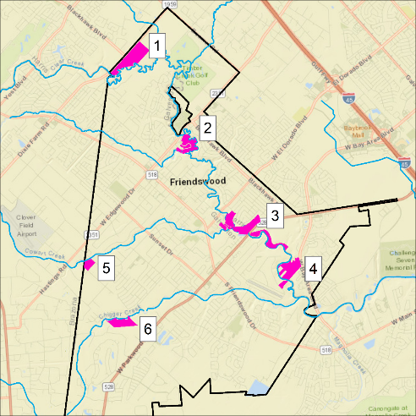
We did Ask For Modeling of 6 Proposed Detention Ponds
Six proposed ponds were modeled simultaneously in Vflo using GIS shapefiles provided.
Pond # | Designed Acreage
1 | 73.0
2 | 36.5
3 | 64.2
4 | 53.1
5 | 21.2
6 | 33.3
*When modeling, drainage areas into ponds were assumed to be about 3x the designed acreage.

Slide 23
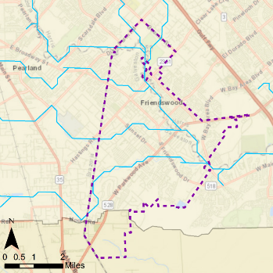
As Example Detention Pond at Whispering Pines
Cross-section at Watch-point 4 (Harvey)
4
Water Elevation Changes Due to Detention – 100 Yr. Storm
Location | WSEL change (ft)
FM 2351 | -0.01
Whispering Pines | -0.02
FM 528 | -0.05
Bay Area Blvd. | -0.14
I-45 | -0.20
Clear Lake | -0.15
Changes are minimal.
In Harvey Storm even less held due to filling up early.
To have an affect in Harvey would need a 4500 acre pond somewhere upstream.

Slide 24
Diversion
Modeled diverting water out of Clear Creek at Bay Area Bridge and finding another path to the Gulf other than going down and out Clear Lake.
The positive effects occur mainly near and below the diversion point.
Further modelling needed to better define
Does require moving the water across other watersheds
Significant land acquisition needed, little of this actually in Friendswood.
Project cost would exceed $300M and would have to be done by USACE.
 | WSEL Change (ft), Diversion Pt at Bay Area Blvd
Location | 10% Div | 25% Div | 50% Div
FM 2351 | -0.02 | -0.04 | -0.07
Whispering Pines | -0.08 | -0.18 | -0.31
FM 528 | -0.17 | -0.37 | -0.64
Bay Area Blvd. | -0.65 | -1.54 | -2.77
I-45 | -0.68 | -1.63 | -3.03
Clear Lake | -0.40 | -0.65 | -0.67
Friendswood’s portion of cost would be less than 5%.
Other cities and agencies would control this.
There are other diversion type projects that need to be modeled and we will be asking Dr. Bedient’s group to do these
Friendswood should remain interested in this and if the project was triggered by other agencies we would want to support

Slide 25
What is an Observation
It is a conclusion the team has reached basis its research, much of which has been presented to council already, and is supported by a majority of our team.
Each Observation has multiple premises that help us reach the conclusion
Observations can be in the area of mitigation projects, costs, implementation, political concerns, safety, and environmental….and more.
To change an observation to something better one needs to attack the premises.
From the Observations and Premises we have formulated recommendations.
Please Note: As we go through these we sometimes show reminder data but in most cases we assumed Council remembers things we have shown in the past. If something is confusing please ask.

Slide 27
Observation 1
Friendswood experiences catastrophic flooding when the watershed receives rainstorms of 24 inches or more in less than two days.
Why Do We Say This?
From previous chart….such storms are occurring more frequently than the published probabilities of 0.2% (500 yr.) in any given year.
There have been three major storms (Claudette (1979), Allison (2001) and Harvey (2017) that have occurred in the last 40 years (Statistically at a 7.5% per year likelihood.)
Storms of lesser severity can cause localized flooding but do not create the wholesale flooding of significant portions of the city.
Further development of the watershed will exacerbate the effects of such storms or will cause smaller storms to have the same impact. Note the changes just in the last decade.

Slide 28
Observation 2
In Friendswood, and all other areas, flooding of Clear Creek occurs because enough water cannot either be stored upstream or drain fast enough to the ocean during storms as shown in Observation 1.
Why Do We Say This?
Methods to reduce flooding:
Reduce the amount of water entering Clear Creek in Friendswood during storms (DS)
Increase the ability to flow water out of Clear Creek during storms (R).
About 300,000 acre-feet of water came to Friendswood in Harvey. ~2/3 that in Allison and Claudette.
Acquisition of property will be required to implement these options.
In Harvey, tributaries in Friendswood were not restrictions but backed up when they couldn’t exit to Clear Creek.

Slide 29
Observation 3
Over the last 80 years, the Clear Creek watershed has been significantly changed by humans for land use. This has altered the physics of the flow.
Why Do We Say This?
Portions were straightened and widened to reclaim wetlands for farm use and later for residential areas.
Some areas have not been altered and retain their natural unimproved watercourse such as we have in Friendswood.
Clear Lake, is extensively developed at the outlets of the Clear Creek watershed to Galveston Bay.
Again note the Lidar changes in just the last 10 years.

Slide 30
Observation 4
There are multiple jurisdictions in the Clear Creek watershed that pass water into Clear Creek without any further responsibility.
Why Do We Say This?
The land mass of the jurisdictions that drain to Clear Creek in Friendswood is seven times the size of Friendswood.
Jurisdictions generally apply a 1% storm criteria for land use which are not the type of storms that currently cause wholesale flooding. Some jurisdictions are beginning to make changes.
There is no overall governing body although the current Clear Creek Watershed Steering Team has an advisory role.

Slide 31
Observation 5
Currently the City of Friendswood considers their role is to move water effectively from property owner boundaries to the nearest creek or drainage waterway to Clear Creek.
Why Do We Say This?
This is consistent with other jurisdictions in the watershed.
To the extent that the infrastructure exists.
There are some areas or pockets of the city that flood in big storms, that shouldn’t and may have a local drainage issue.

Slide 32
Observation 6
The City of Friendswood’s general fund is inadequate to fund projects necessary to mitigate flooding of Clear Creek from the storms in question.
Why Do We Say This?
The city is hampered by not having capital funds to support shared funding or pre-funding and payback projects.
The city’s yearly general fund is ~$25M whereas mitigation projects could be an order of magnitude larger.
Funding will be required from other sources and the city will be required to aggressively pursue this funding and be vocal about how funds are disbursed

Slide 33
Observation 7
Cities and areas that are successful in advancing flooding projects nationwide have built in a structure that ensures a Constancy of Purpose to create a long term strategy..
Why Do We Say This?
Review HCFCD, Rochester, MN, others studied, Cedar Rapids, Iowa, New Orleans…ect.
This is a deceptively important observation.

Slide 34
Observation 8
There are multiple Harvey related funding streams available (Federal, State, County). Some agencies (USACE, Harris County) have already been funded and projects in early stages of implementation. The impacts on Friendswood of these projects has not be adequately demonstrated to the Sub-Committee.
Why Do We Say This?
Harris County had received direct Federal Funds. Other counties, including Galveston, have not received direct funds yet. It is currently not clear how the money will be shared.
Friendswood has applied for Federal and State funding for property buy-outs but some have not been approved and some are pending.
Projects are scheduled on areas like upstream Clear Creek in Pearland, Mud Gully, and Turkey Creek.
Simulations results shared with the sub-committee were for 1% storms only. Sub-committee has requested USACE perform simulations on storms like Harvey but have not received the information yet.

Slide 35
Caveats of Observations
The Team Stayed within its Charter to examine flooding and fixes. There are a number of areas not addressed but some of the important ones are:
Projects might have environmental impacts that will have to be addressed.
Projects such as retention, detention, and terracing of Clear Creek may afford opportunities to create appealing benefits such as parks, sport fields, nature trails, etc.
The Sub-Team did not define the cost of this
This could be part of the presentation to voters regarding the bond

Slide 36
Recommendations
Our recommendations are based on the data we collected and the observations we have shown both tonight and in previous report-outs to the City Council of Friendswood.
Some recommendations attack multiple observations.
We intend for all recommendations to be actionable by the Friendswood City Council if it so chooses.

Slide 37
Recommendation 1
The City of Friendswood City Council needs to clearly state, through a resolution, that the work of the sub-committee generates a cause for action to mitigate rainstorm flood events.
Why?
Does the City Council of Friendswood agree that catastrophic flooding rainstorm events give cause for action? The back-up has been provided in all sub-committee presentations.
A resolution would demonstrate commitment.
The sub-committee can recommend wording but we believe the council can generate the wording they prefer

Slide 38
Recommendation 2
The City of Friendswood City Council accepts that there are a number of mitigation projects that need to be pursued to completion to significantly reduce flooding in Friendswood. These all involve the main stem of Clear Creek.
Why?
The main stem of the creek is the problem. Tributaries flood by backing up.
The methods to reduce flooding are either store more water, drain it faster, or remove structures from properties that flood.
The mitigation is expensive and will take time to acquire matching funds, perform engineering, acquire rights-of-way, and implement the projects

Slide 39
Recommendation 3
Go to the Friendswood voters with a bond vote that would provide a cost share of $32M in projects over the next 15 years. This money can ONLY be spent on drainage projects associated with the main channel of Clear Creek.
Why?
The cost to complete the needed projects is much higher than the $32M, but this amount allows us to leverage other funds available.
Without having money to spend on flood projects Friendswood will be frozen out of consideration for many direct impact projects.
Amount determined by the number of projects, their positive effects, their costs, expected percentage Friendswood would have to contribute and the time frame.
Determine the net impact on taxes for bonds drawing over that period of time.
Rely on Drainage districts to continue to work on tributaries.

Slide 40
Estimated Costs of Projects with the Best Benefit
Costs based on engineering estimates for similar work.
While Dr. Bedient’s work showed the FM2351 Bridge that while raising has a bigger impact, we believe for public safety two bridges should be elevated. But also note the terracing should reduce the flood heights which also help bridges stay passable

Slide 41
Estimated Spend Rate for Projects Listed

Slide 42
Recommendation 4
Hire a long term Clear Creek Watershed Drainage coordinator for in the City of Friendswood to create a long term strategy and a Constancy of Purpose
Why?
Experience shows with government to ensure something gets done and to have a long term approach it has to be one person’s clear job and that they are held accountable for progress.
City Manager is responsible for defining the job description, hiring, and managing the performance toward the long term goals.
The City Council should be very active in the progress of this work and expect routine reporting in Council meetings
Needs to have a budget to successfully complete the project and continues the sub-committee work on mathematical simulations.
Responsible for Clear Creek drainage project definition, spending, grant writing, interaction with other jurisdictions, and interaction with the public. .
Monitors projects on Clear Creek and requires simulations that show the effect of these projects during storms sizes that flood Friendswood.

Slide 43
Recommendation 5
The City of Friendswood should review and change its current permitting criteria regarding drainage to reflect the realities of the types of storms that occur here.
Why?
Design criteria for new construction at the 1% storm level are inadequate.
Optimally this should be done in conjunction with other municipalities up and down the creek.
Current existing structures would be grandfathered unless substantially altered.

Slide 44
Recommendation 6
The acquisition of properties will be required to adapt Clear Creek to meet the demand for drainage. The City of Friendswood will need to have the means to acquire properties for drainage projects.
Why?
This is included in our calculations for the Bond needs
Quick response to purchase damaged properties after a flood event
Purchase of properties as they go on the market at any time.
Unsolicited offers.
Privately owned properties cannot be used for drainage projects.

Slide 45
Recommendation 7
The City of Friendswood needs to be proactive regarding the management of the flow of water down Clear Creek. The City of Friendswood should take the leadership role in organizing municipalities along Clear Creek to create a common purpose in fixing the creek.
Why?
It is our citizens who flood.
There are over a half dozen agencies involved in Clear Creek. Recognize the responsibilities of other entities and need to increase our presence to support these groups.
The current master plan for the watershed needs improvement.
Solutions have to involve land use and the larger cities on the watershed control this.
As a city council reach out to other cities to initiate communications. Initial discussions with League City leadership indicate they are of a like mind on this.

Slide 46
Recommendation 8
There are currently several efforts to restructure watershed management being contemplated at the county and state level. The City Council needs to be active and participating in this and determining if these efforts will be beneficial to Friendswood and resisted if not.
Why?
Generating watershed control systems can be hugely helpful so long as they are focused on the entire watershed, they are governed fairly, and they are resourced property.
Care should be given to ensure that changes do not reduce effective current drainage system.
Until the Drainage Coordinator job is filled, Council should determine a method to evaluate changes coming from either the counties, or state.

Slide 47
Recommendation 9
The focus should entirely be toward the future. There is no justification to seek redress directed at upstream or downstream entities for the changes that have occurred along Clear Creek.
Why?
Many of the significant alterations of the Creek were done a long time ago and continue to this day and will continue in the future.
All municipalities comply with current laws and ordinances.
State and Federal law would not support being successful in legal action
Friendswood too has allowed development, including houses built right on the creek, that have also contributed to the problem.

Slide 48
Recommendation 10
There are small areas of Friendswood that flooded during Harvey that were not caused by Clear Creek. The city should be directed to research these and propose fixes.
Why?
May require funding not part of bond capital which is dedicated to Clear Creek’s main stem.
This may require general funds to budget for and to perform the repairs.

Slide 49
Recommendation 11
For both flooding and safety during flooding events, greatly increase the monitoring of creeks in Friendswood. There are blind spots on Clear Creek and tributaries in Friendswood regarding inundation levels and rain gauges. This affects safety and the ability to give first alerts to issues. Add more of these in critical areas.
Why?
Work with the flood control districts to increase the number in critical areas.
These instruments can give valuable real time data in storms that can trigger local or large evacuations and later rescue work.
The information is valuable in later analysis of what occurred during storms of all levels.
Consider adding flow rate sensors and video monitoring at critical spots.
All this information should be available to the Friendswood Emergency Operations Command Center and available to the public in real time.

Slide 50
Summary of Actions for Council Needed Tonight
The Sub-Team should present information to the Bond Citizen’s Advisory team about the bond portions of the recommendations.
This should be done soon!
Do we have Council’s permission to do this?
If so, what instructions should be relayed to the Advisory team about this information and their ability to interact with it?
The Drainage Sub-Committee as met its original charter to make recommendations back to the city council that are fact-based only and include project types, costs, societal impacts, and political obstacles.
Originally expected to make recommendations back within 6 months…..it took us 8 months! But at least we were faster than the Mueller report!
Will be producing a written report capturing all the information gained for posterity.
There is on-going work with Dr. Bedient’s group to further define project effects and this will continue for some time. Options:
Staff could keep this moving.
Council could re-charter the current team to do this work
Council could charter a new sub-committee to continue this work

Slide 51
Summary of Actions Needed in the Next Few Months
Recommendation 1 …. Does Council agree with the overall findings and recommendations and will they generate a resolution to that?
Do they support the Bond numbers for Drainage?
Develop plan and budgeting for Clear Creek Drainage coordinator
To city staff and P&Z on whether to review permitting requirements in light of Sub-committee data.
Focus for staff on buy out programs which will be taken over by drainage coordinator.
Have already had discussions with League City leadership and they are interested in linking up with Friendswood regarding Clear Creek.
Ask staff to keep council up-to-date on watershed bills in the legislature
Ask staff to create a plan and budget for 2019-20 for isolated drainage area repairs.
Work with Drainage districts to submit plan and cost sharing for improvements to measurement of the creek.

