Slide 1
Citizens Advisory Team
Kick-Off Meeting March 5, 2019

Slide 2
Why are we all here tonight?
We are all invested in the City of Friendswood
Meet other citizens who are interested in our City
Get to know more about the City’s assets and needs
Provide input into how limited resources are used

Slide 3
Purpose of a Citizens Advisory Team
The damage caused by Hurricane Harvey showed investment is needed in drainage improvements
Evacuation/mobility enhancements also a concern

Slide 4
Purpose of a Citizens Advisory Team
What other needs are out there
(i.e. mobility, facilities, etc.)?

Slide 5
What is a General Obligation Bond?
Similar to a home mortgage
Financing tool to fund large capital projects over multi-year period

Slide 6
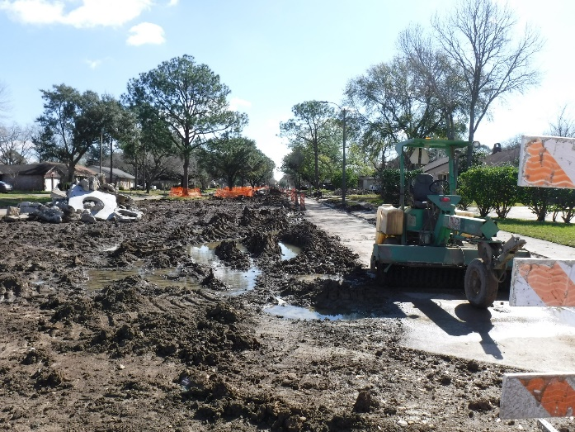
Why issue bonds?
Infrastructure constantly aging
Balancing act between repairing versus replacing
“Generational equity” Allowing all users over the life of an asset to pay their share

Slide 7

Why issue bonds?
Neglecting infrastructure can cost much more than periodic scheduled maintenance

Slide 8
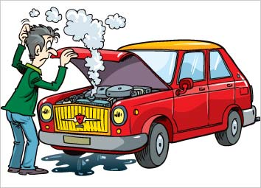
Why issue bonds?
Catastrophic failure eventually occurs if left unchecked
Even with routine maintenance, total
replacement will be needed

Slide 9
Why issue bonds?
Many capital projects exceed the City’s ability
to fund on a “pay as you go” basis
Bonds allow the City to pay for more costly projects over a longer period of time

Slide 10

What kind of credit rating does Friendswood have?
Standard & Poor’s : AA-
Based on the City’s strong financial liquidity & solid ability to meet
existing debt service obligations

Slide 11
What kind of credit rating does Friendswood have?
The rating indicates a low risk investment for lenders
City able to obtain lower interest rates on bond issuances

Slide 12
Bond Election?
Drainage improvements have been identified as a need
Are there others?

Slide 13
2013 Experience
More than 80 residents convened
--Reviewed the City’s planning documents
Capital Improvements Plan
Comprehensive Plan
Budgets and other financial information

Slide 14
2013 Experience
Met with City staff and other boards, commissions, and committees
to gather facts.

Slide 15
2013 Experience
Their effort culminated in four bond propositions:
New Fire Station headquarters and expansion of Fire Station 4
Expansion of the Library
New Parks and expanded services at existing ones
Multiple road reconstructions
Voters approved $24M worth of projects

Slide 16
Proposition 1 - Fire Stations

Slide 17
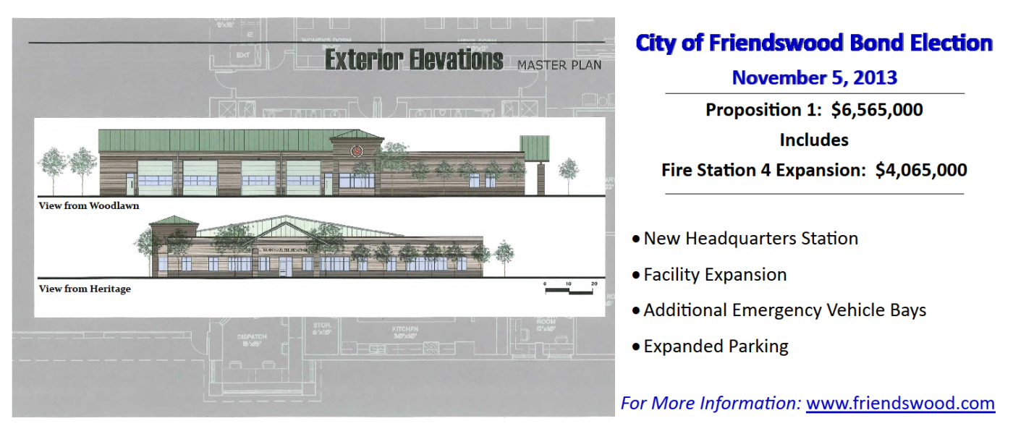
Proposition 1 - Fire Stations

Slide 18
Proposition 1 - Fire Stations

Slide 19
Proposition 2 - Library

Slide 20
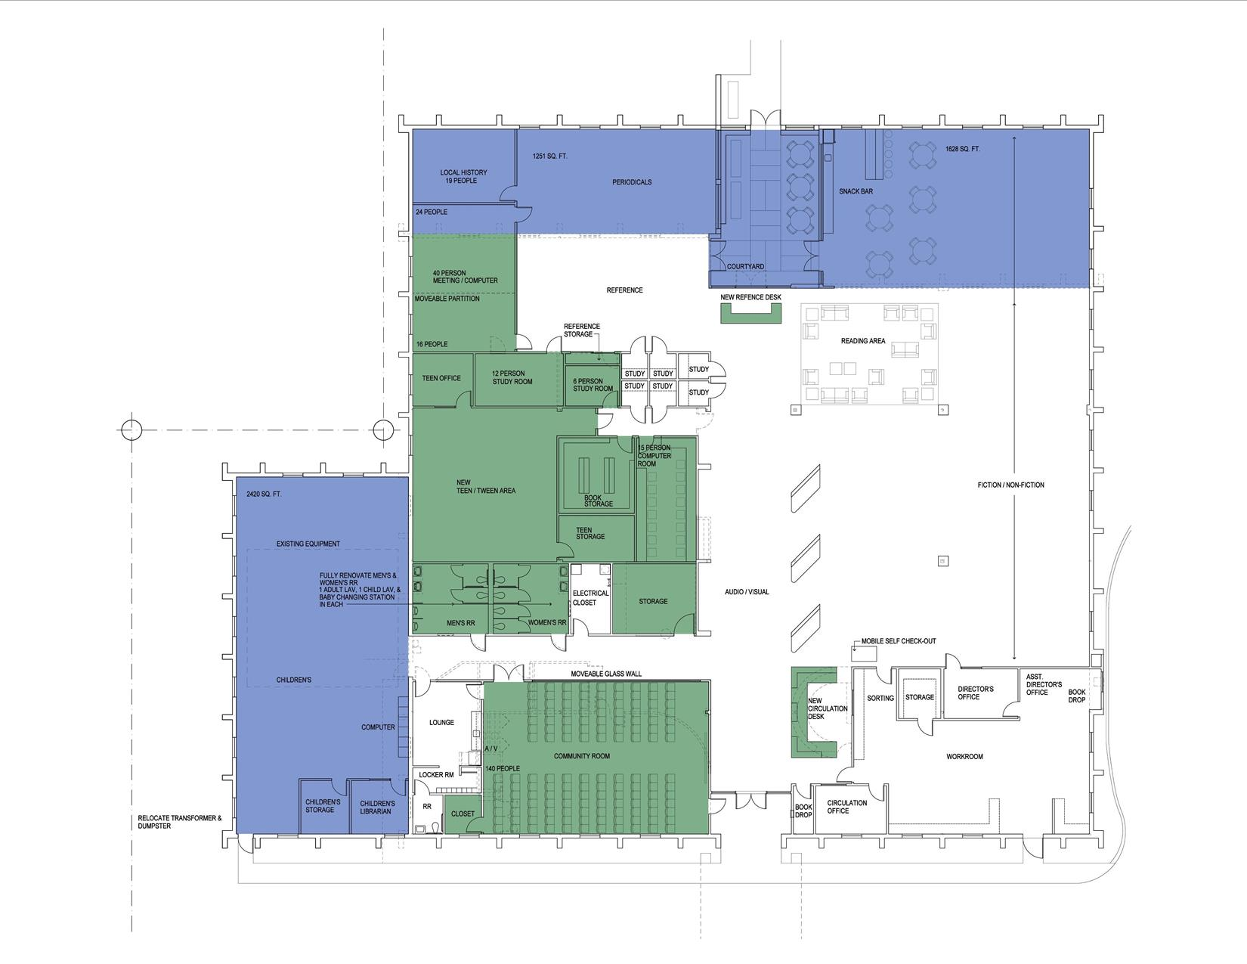
Proposition 2 - Library

Slide 21
Proposition 3 - Parks

Slide 22
Proposition 3 - Parks

Slide 23
Proposition 3 - Parks

Slide 24
Proposition 3 - Parks

Slide 25
Proposition 3 - Parks

Slide 26
Proposition 3 - Parks

Slide 27
Proposition 3 - Parks

Slide 28
Proposition 4 - Streets

Slide 29
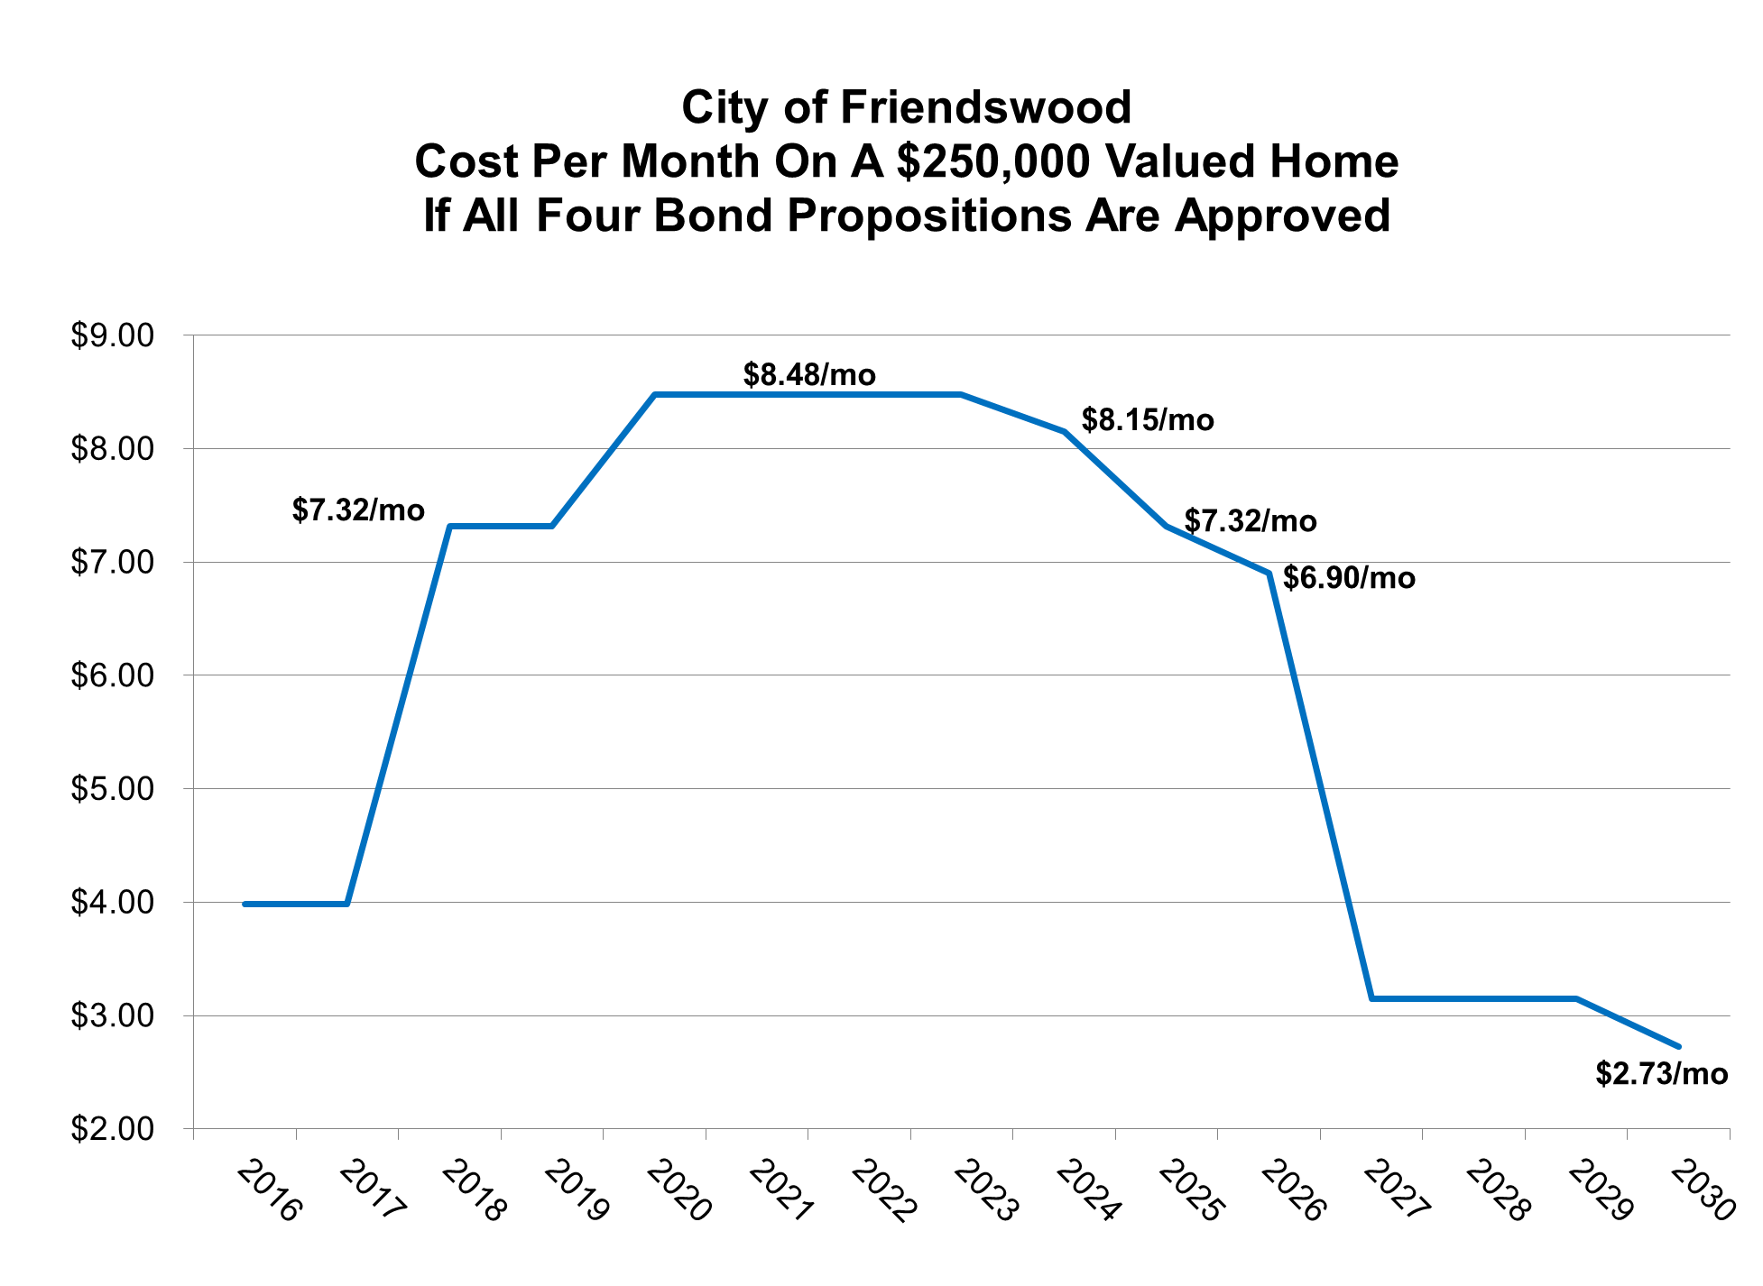
2013 Experience
Educational data developed highlighting financial Impact

Slide 30
What happens if the bonds are not approved by the voters?
If a bond proposition does not pass and funding is not available to complete the work, that project is held for possible inclusion in any future bond packages.

Slide 31
Can bond funds “cross over” and be used for other purposes? For example, could unused street money be used for parks, library or fire stations?
No, bond funds can only be used for their intended
purpose as described by each proposition.

Slide 32
Are you interested in serving?
If so…
Write your contact information on the sign-in sheet in the back
Fill out and submit a volunteer application
Become familiar with the resources at www.friendswood.com/CAT

Slide 33
Are you interested in serving?
As the process moves forward, staff will be available to provide resources
Next meeting ___________

Slide 34
Thank you!

