Slide 1
November Bond Election
August 5, 2019 Council Meeting

Slide 2
Topics
Drainage Questions
  Drainage Subcommittee Estimates
  Factors of Contingencies Included by the Subcommittee
  Proposed Estimates
Other Ballot Propositions

Slide 3
Drainage Subcommittee Estimates

Slide 4
Factors of Contingencies Included by Subcommittee
Over excavation
  Cross-section of terrace assumed to be a standard polygon
  Clear Creek’s serpentine nature - overlapping terraces
Additional 30% on top of that

Slide 5
Over Excavation: Cross-Sections

Slide 6
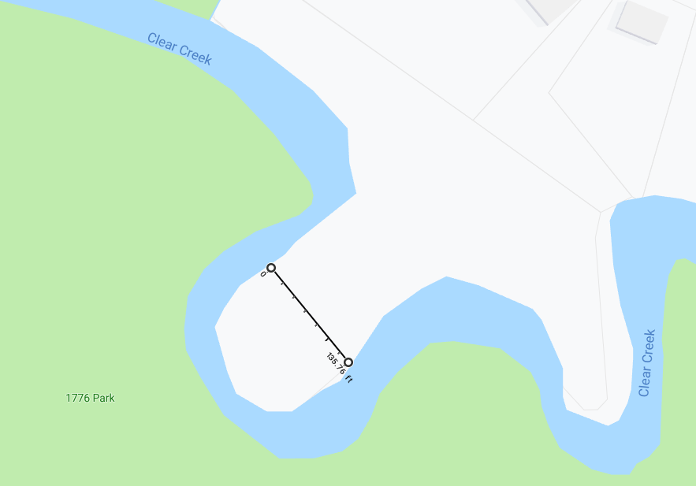
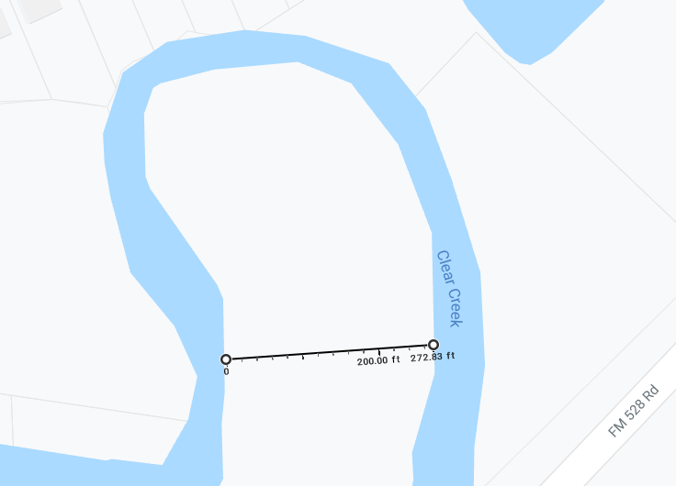
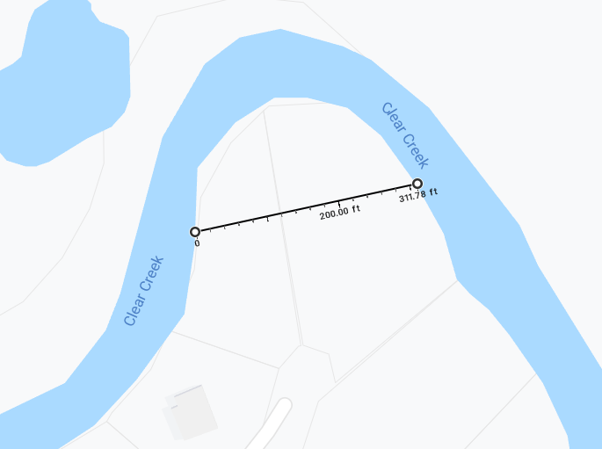
Over Excavation: Creek’s Serpentine Nature

Slide 7
Drainage Subcommittee Estimate
Original Estimate $173M; local share $31.8M
Buyouts included: 60 properties at $500K a piece
Local share estimated at 18% on average (some 10%, 20%, and 25%)
Subtracting bridges and de-snagging efforts: $130M; local share $27.5M

Slide 8
Proposed Estimates

Slide 9
Proposed Drainage Estimates
Inflation factor could be added: 3% compounded annually
  However, City is not waiting 15 years to spend funds
  Realistically there’ll be three issuances in five-year windows
Results: inflation approximately $6M on a $35M bond proposal
Local share bumped up from 18% to 25%

Slide 10
Drainage Questions
Who will are partners be for the 25% local share?
  Partners will typically include local entities with State and Federal agencies (GLO, TDEM, FEMA, Corps, etc.)
  Local share partners: GCCDD, HCFCD, Galveston County
Is inflation needed if estimates were already padded?
How much should we ask the voters to authorize?

Slide 11
Other Ballot Propositions
Bond attorney advised limited grouping of projects
Therefore, six propositions:
  Public Works Facility
  Public Safety
  Community Center/Shelter
  Transportation
  Parks
  Drainage

Slide 12
Public Works Facility
The issuance of $2M tax bonds for the purpose of designing, constructing, improving, and expanding the Municipal Public Works Facility located off of Blackhawk Blvd in the City.

Slide 13
Public Safety
The issuance of $9.1M tax bonds for constructing, improving, renovating and equipping public safety facilities for the Fire and Police Departments, consisting of the Municipal Public Safety Building and a new Fire Station and Training Field to replace Fire Station Number 2 in the City.
  Fire Station 2 and Field Training Upgrades - $4.1M
  Public Safety Building Phase 2 - $5.0M

Slide 14
Community Center/Shelter
The issuance of $9.0M tax bonds for the purpose of designing, constructing, improving, and expanding the Municipal Community Center located off of Morningside Drive in the City.

Slide 15
Transportation
The issuance of $7.6M tax bonds by the City of Friendswood, Texas for improving, renovating, upgrading and reconstructing transportation and pedestrian facilities in the City, including improvements to existing streets and roads in the City and other related costs, including the extension of Friendswood Lakes Boulevard (also known as Friendswood Parkway), the installation of sidewalks throughout the City and various traffic enhancements along major collector and arterial roadways in the City.
  Friendswood Pkwy - $4.5M
  Sidewalks - $2.1M
  Traffic Enhancements - $1.0M

Slide 16
Parks
The issuance of $8.0M tax bonds by the City of Friendswood, Texas for designing, constructing, improving, expanding and equipping parks, trails and recreational facilities in the City, and the acquisition of land and interests in land for such purposes, including improvements to, and expansion of, Stevenson Park, Old City Park, Renwick Park, 1776 Park and the City Pool.
  Stevenson Park/Old City Park Upgrades - $2.0M
  Renwick Park Upgrades - $1.5M
  1776 Park/Clear Creek Green Belt - $500K
  City Pool Phase 1 - $4.0M

Slide 17
Pool Options

Slide 18
Drainage
The issuance of $41.0M tax bonds by the City of Friendswood, Texas for constructing, acquiring and installing stormwater drainage and flood control improvements along Clear Creek throughout the corporate limits of the City, including dredging, channel improvements and related infrastructure and utility relocation and the acquisition of land and interests in land necessary for said improvements.

Slide 19
Tax Rate Impact
At 1.0% to 1.5% valuation growth annually, maximum impact $0.0935
For $75.0M Bond Proposal, issued $5.0M annually for 15 years

