Slide 1

Friendswood Citizen’s Bond Group
June 3, 2013

Slide 2
Agenda
Introductions and Opening Remarks
Presentations by Group Chairs
  Streets and Drainage
  Parks and Recreation
  Facilities
  Finance
Recommendations and Conclusions

Slide 3
Introductions and Remarks
Acknowledgements –
  City Council
  City Manager and staff
  Over 80 citizens from our City
  David Disiere
Notes:
City Council – For making this effort possible and the vision to look to the future for our community
Roger Roecker, City Manager, For putting this effort together and for providing resources to assist the Group in making these recommendations. He not only made others available, Roger himself was available to meet at any time with members of the Group. Also, thank Roger’s staff – Morad, James Toney, Cindy Edge and others.
Over 80 citizens in our City – Citizens from all parts of the city with amazing expertise and disciplines and interests came together to work together for the betterment of the community
David Disiere – For providing leadership as Chair and providing space for meetings – free of charge. Has undergone surgery recently, is in recovery, and Ron Cox was drafted to make this presentation on behalf of the Group, in David’s place.

Slide 4
Introductions and Remarks
City Manager Charge
  To review and make recommendations for a potential bond issue.
    Provided information and personnel resources
City Manager or staff never influenced the outcome for this group

Slide 5
Introductions and Remarks
Bond Advisory Group
  Four different focus areas (subgroups)
    Streets and Drainage
    Parks and Recreation
    Facilities
    Finance
  Full Group met 8 times; Subgroups met numerous times
    Met with citizens and staff
    Carefully reviewed
      Capital Improvements Plans
      Financing structures and options
Notes:
Bond Advisory Recommended Focus Areas:
Stevenson Park Expansion and Improvement (13%)
Land acquisition
Improved lighting and security of trail, tennis and parking
Overflow parking
Sports Parks – Expansion and Improvements (33%)
Improve infrastructure at Renwick & Sports Park
Installation of new ball fields (baseball, soccer, football, lacrosse) in existing or to be acquired property
Land acquisition
Centennial Park Improvements (12%)
Basketball Pavilion
Improve lighting of drainage and JH fields (FISD joint venture)

Slide 6
Introductions and Remarks
  Friendswood Population Growth
51% growth since 1994
366% growth since 1975
6
Notes:
6

Slide 7
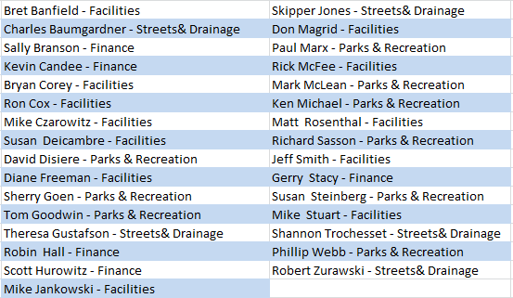
Subgroup Members

Slide 8
Introductions and Remarks
Rationale for Recommendations
  Vision 2020?
  Enhance safety?
  Promote Friendswood as the #1 City?
  Improve efficiency in operation?
  Increase attractiveness to prospective businesses?
  Improve quality of life?
  Improve infrastructure?
  Prepare Friendswood for build out?
  Benefit to what percentage of residents?
  Increase value of homes and businesses?

Slide 9
Group Reports

Slide 10
Streets & Drainage

Slide 11
Streets: Major Thoroughfares
The Friendswood Major Thoroughfare Plan identifies Boulevard, Collector Street and Major Thoroughfare improvements in the City
Brittany Bay Boulevard will eventually be needed in Friendswood to mitigate traffic pressure on FM 518/528 and in other areas of the City
Pursue extension of eastbound left turn storage lane on FM 518 at FM 2351 to maximum allowable length with TXDoT

Slide 12
Friendswood Drainage
  The Streets & Drainage Subgroup is not recommending any immediate Drainage Improvement Funding Package for Friendswood at this time.

Slide 13
Streets & Drainage Subgroup
Recommendation Summary
Acquire funding now to proceed with the $7.638M Friendswood Street Rehabilitation Package recommended
Evaluate $5.702M in deferred Friendswood Street Rehabilitation Projects as future Capital Improvements
Adjust Friendswood Streets O&M budget in the future, as required to support the growing scope of maintenance work on Friendswood roadways and pavement infrastructure in the City
Increase Friendswood drainage funding in the future, as required to support unfunded drainage improvements and growing drainage infrastructure in the City.
Pursue major thoroughfare improvements in the City (e.g., Brittany Bay Boulevard), as needed to mitigate traffic pressure at the appropriate time and when external funds & easements can be secured

Slide 14
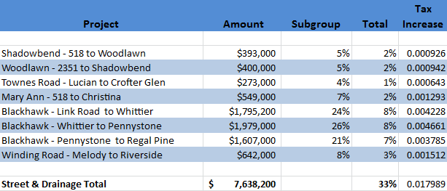
Recommendations

Slide 15
Parks & Recreation

Slide 16
Parks & Recreation
Top 5 requests from 2009 survey of Friendswood Citizens
Develop more park facilities and programs
Develop more neighborhood parks
Develop more hike and bike trails
Building larger community parks
More open space

Slide 17
Parks & Recreation
Land Acquisition
Mini Parks, Neighborhood park, greenways, nature parks, sports parks
Expansion of Parks
Sports Parks, Stevenson Park
Lake Friendswood
Park Improvements
Stevenson Park, 1776, Imperial Estates, Sports Park, Centennial Park

Slide 18
Parks & Recreation Subgroup
Recommendation Summary
Acquire new park land to increase the number of acres per resident to be closer to the recommended average for a city our size.
Expand the existing parks with additional land.
Improve the existing parks with new amenities for all ages from the kids to the over 65 generation.
Open and make accessible Lake Friendswood

Slide 19
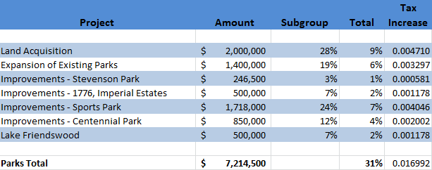
Parks & Recreation Recommendations

Slide 20
Facilities

Slide 21
Friendswood Public Library
Mission Statement:
  To engage, educate, entertain and empower every family member and business in our community
  To be the foremost promoter of self-directed life-long learning
  To be a vibrant library where people want to be
In addition to lending books, audio books, CDs, and DVDs, the following community services are also provided:
  Youth and Young Adult Services
  - Reading and craft programs, education programs,
  after school programs, Teen Advisory Group
  Adult Services
  - Classes (PC), Classic movie night, cultural/educational
  programs, reading programs
  New Resources
  - Wifi/Internet access, PC/MS Office access
Notes:
21

Slide 22
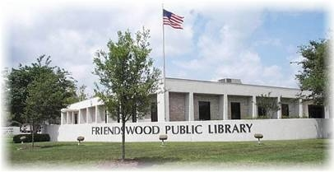
Friendswood Public Library
Library's current footprint (1994) and usable space (1997) no longer meets the current and future demand for the resources and services provided
1994 - 13,379 SF
1997 - 15,249 SF
Notes:
22

Slide 23
Friendswood Public Library
Three options were considered in 2011.
Renovation of existing space and additional 6,000 SF
Meets current and long term needs for Friendswood
$2 million cost estimate:
- Renovate existing space 15,249 SF $500K ~$33 SF
- Added footprint ~6000 SF $1.5M ~$250 SF
- Combined ~21,000 SF $2.0M ~ $95 SF
Other two options (remodel with no or modest expansion) do not provide adequate space
All three options assume the Library is kept at the current location and there is room for extended the parking.
Notes:
23

Slide 24
Friendswood Fire Department
Due to growth and increase in demand for services, Friendswood Fire Department’s facilities are no longer adequate:
  Main Station #1 (1000 S. Friendswood Dr., built in 1975) is too small and needs significant structural improvements and repairs.
  The present locations of the four current Fire Stations do not meet the recommended minimum Insurance Services Organization and NFPA coverage requirements (2 mile radius) for all sections of the city.
Notes:
24

Slide 25
Friendswood Fire Department
Critical Needs:
- New Main facility with adequate space
- Complete geographical coverage with adequate response times
- Improved structural strength for disaster readiness (hurricane)
With the goal of:
- Reduced response time to area covered
- Meeting minimum standards and potentially improving insurance rating
- Provide fire/rescue training for volunteers
- Continuing to provide Community Activities and Education
    Fire prevention education
    CPR classes
    4th of July activities
Notes:
25

Slide 26
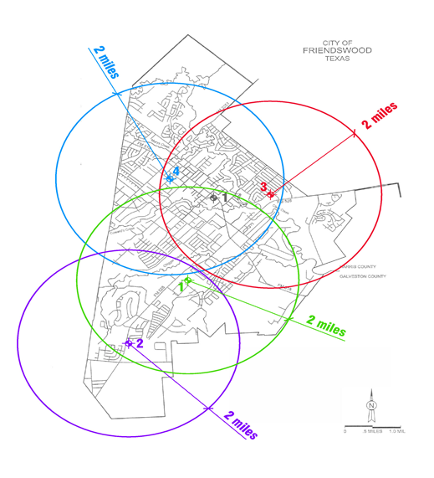
Friendswood Fire Department
Notes:
26

Slide 27
Facilities Master Plan
  Many unmet needs in facilities, but no reliable study, except for Library and Fire Department.
  Evaluation of usability of Fire Station #1 if new station is built.
  Results may or may not indicate additional or different funding of facilities projects
  Recommend immediate funding for a facilities study

Slide 28
Facilities Subgroup
Recommendation Summary
Expansion of Fire Station #4 as new Headquarters Fire Station with space for the EMS Department.
Build a new Fire Station at the Public Safety Building to replace Fire Station #1.
Expand the Library to accommodate the need for larger meeting space, teen area, e-access area and additional meeting space.
Keep the library in the current location where it can remain as the cornerstone of the community.

Slide 29
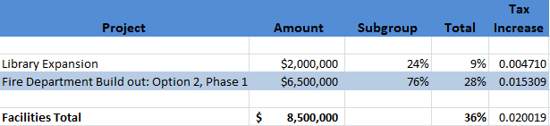
Facilities Recommendation

Slide 30
Finance

Slide 31
Finance Group
Reviewed and reported to the full Group on the financial impact of projects
Provided a rationale for rating the projects consistently among the subgroups

Slide 32
Finance Group
Four Major Sources of Funding:
  Homestead Exemption – 20%
  Sales Tax Increase – ½ cent capacity
  EMS/Fire Contribution - $3/month
  Bonds – Tax increase

Slide 33
Finance Group
Tax Rate Implications
  Rate has been consistently lowered since 2003
  Taxes frozen for over 65 population
  All homeowners still have 20% homestead exemption
  $21 million in bonds would increase tax rate $.05/$100
  Average home value of $217,000 increase of $95.48 per year
  New Home average home value of $346,000 increase of $152.24 per year
Notes:
No capacity to issue bonds without a rate increase
Raising taxes only brings rate to 2003 levels

Slide 34
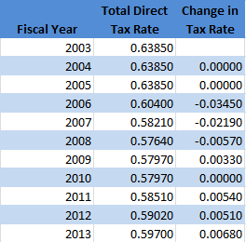
Finance Group
***Effective tax stayed consistent over the years. The change in the tax rate is a direct correlation with the property values.

Slide 35
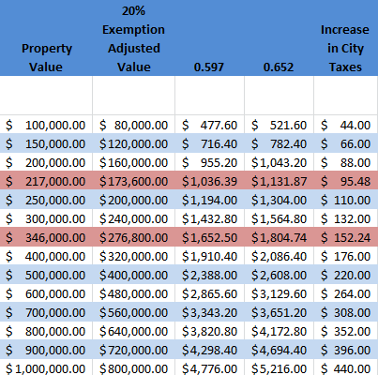
Finance Group

Slide 36
Recommendations and
Conclusions

Slide 37
Recommendations & Conclusions
Over $100 million in identified needs
Group NOT currently recommending
  $73 million in project needs
    Streets and Drainage $43 million
    Parks and Recreation $10 million
    Facilities $20 million
  Funding of short life cycle projects

Slide 38
Recommendations & Conclusions
Bond Group has voted and makes the following recommendations
Bond Amount Tax Rate
  Streets and Drainage - $7,638,200 .017989
  Parks and Recreation -$7,214,500 .016992
  Facilities - Library - $2,000,000 .004710
  Facilities – Fire Dept. - $6,500,000 .015309
  TOTAL - $23,352,700 .055000
Bond Election – November 2013
Ballot Items– At least four separate items
Facilities Master Plan - Immediate

Slide 39
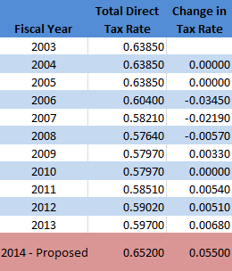
Recommendations & Conclusions
***Effective tax stayed consistent over the years. The change in the tax rate is a direct correlation with the property values.

Slide 40
Recommendations & Conclusions
Group appreciates the opportunity to respond to and make recommendations to meet the needs of the City of Friendswood
Group stands adjourned and ready to assist the Council should you call an election

Slide 41
